Slide 1
STRONG SLOT-AND- FILLER STRUCTURES

Slide 2
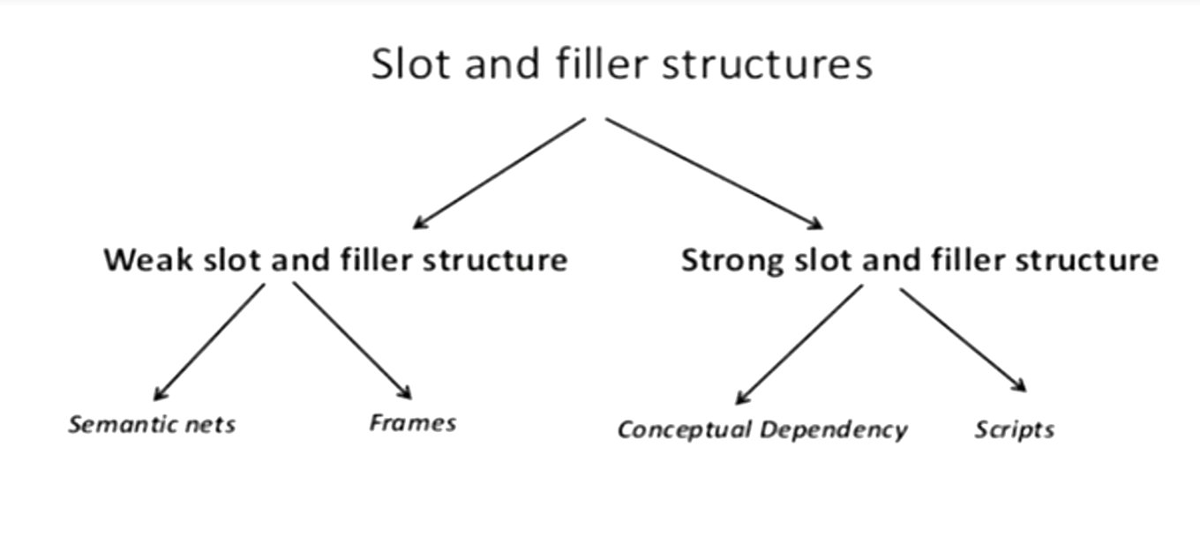

Slide 3
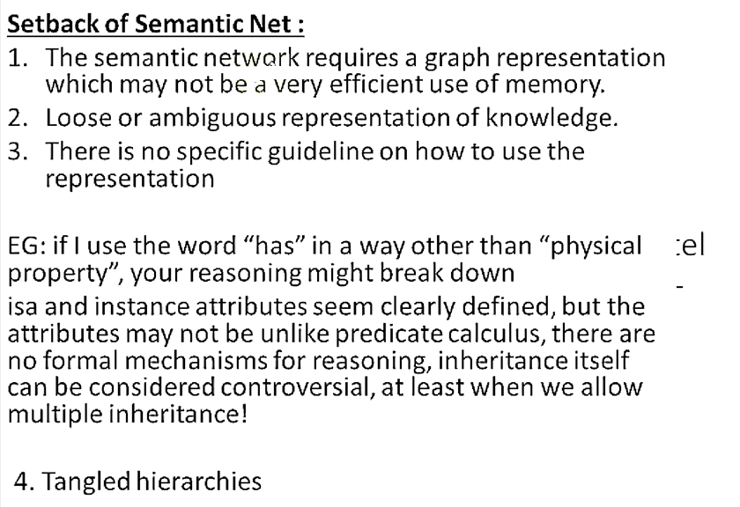

Slide 4
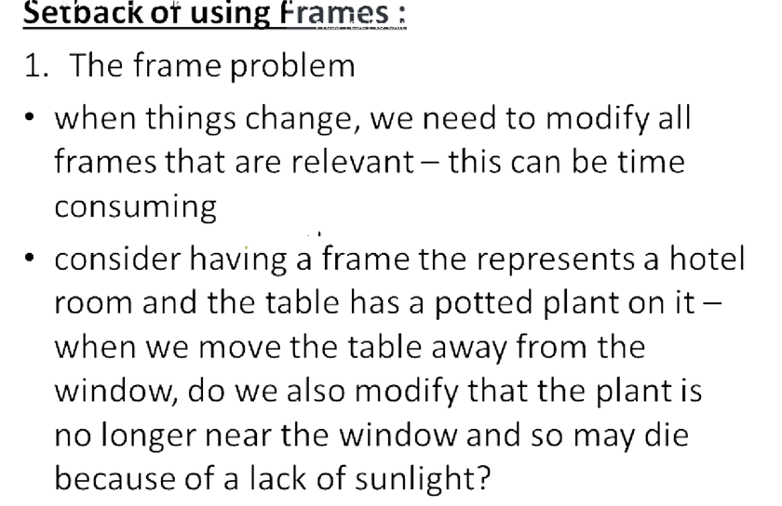

Slide 5
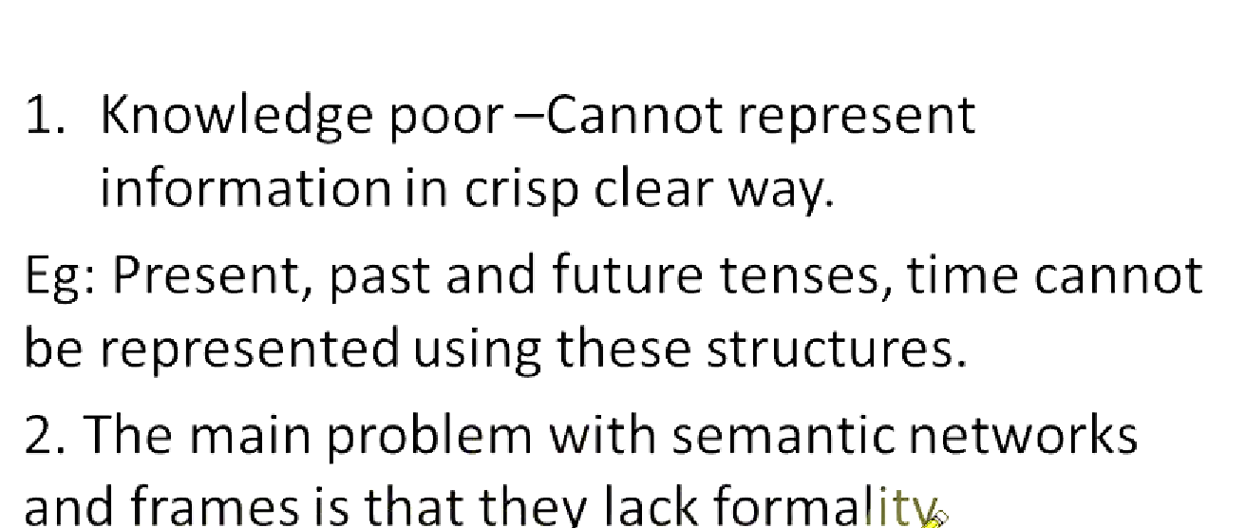
Disadvantage of weak and slot filler

Slide 6
INTRODUCTION
The weak slot-and-filler structures (semantic networks and frames) does not describe any hard and fast rules about what kinds of objects and links are good in general for knowledge representation.
The strong slot-and-filler structures, on the other hand, provides specific notions of what kinds of objects and relations are permitted.
Conceptual dependency (CD) and Scripts are two strong slot-and-filler structures.

Slide 7
CONCEPTUAL DEPENDENCY (CD)
Conceptual Dependencies is a theory to represent the kind of knowledge about events that is usually contained in the natural language sentences.
The goals of this theory are:
To help in the drawing of inference from sentences.
To be independent of the words used in the original input. For any 2 (or more) sentences that are identical in meaning there should be only one representation of that meaning.
The CDs of the following expression will be same:
John gave Mary a book. John gave a book to Mary.
Mary was given a book by John. Mary took a book from John.
Mary received a book from John.
CD representations of a sentence is built out of
primitives , which are not words belonging to the language but are conceptual , these primitives are combined to form the meanings of the words.

Slide 8
BUILDING BLOCKS OF CONCEPTUAL DEPENDENCIES
The basic building blocks is the set of conceptual categories from which dependency structures can be built.
PP-- Real world objects. (Picture Producers)
ACT-- Real world actions. (from set of allowable
actions).
PA-- Attributes of objects. (Picture Aiders). of the form STATE(VALUE). e.g., COLOR(red)
AA-- Attributes of actions. (Action Aiders). e.g., speed
factor in PROPEL
Time of the event—
Location of the event--

Slide 9
SET OF PRIMITIVE ACTIONS
A typical set of primitive acts and their descriptions:
ATRANS: Transfer of abstract relationship (e.g. give)
PTRANS: Transfer of physical location of object (e.g. go)
PROPEL: Application of physical force to an object (e.g.
push)
MOVE: Move of body part by its owner (e.g. kick)
GRASP: Grasping of an object by an actor (e.g. clutch)
INGEST: Ingestion of an object by an actor (e.g. eat)
MTRANS: Transfer of mental information (e.g. tell)
MBUILD: Building new information from old (e.g. decide)
SPEAK: Production of sound (e.g. say)
ATTEND: Focus of a sense organ toward a stimulus (e.g. listen)
EXPEL: Getting rid of an object from body e.g. sweat

Slide 10
ALLOWABLE DEPENDENCIES
The basic dependencies that can be described are provided by set of rules. Each dependency rule is themselves a conceptualization and can serve as a component of larger dependency.
Arrows indicate directions of dependency.
Double arrow indicates two way link between actor
and action.
O- for the object case relation
R- for the recipient case relation P- for past tense
D- destination I- Instrument

Slide 11
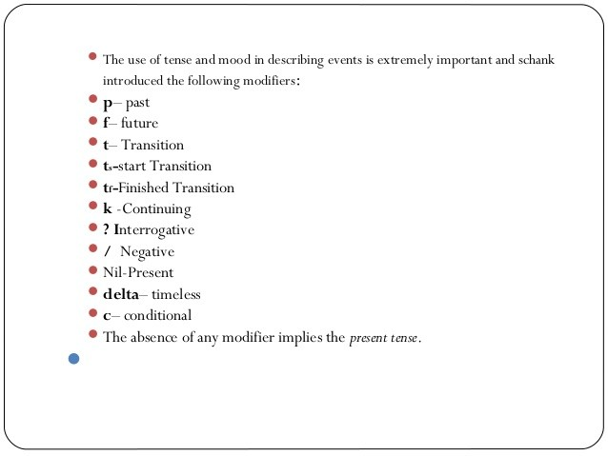

Slide 12
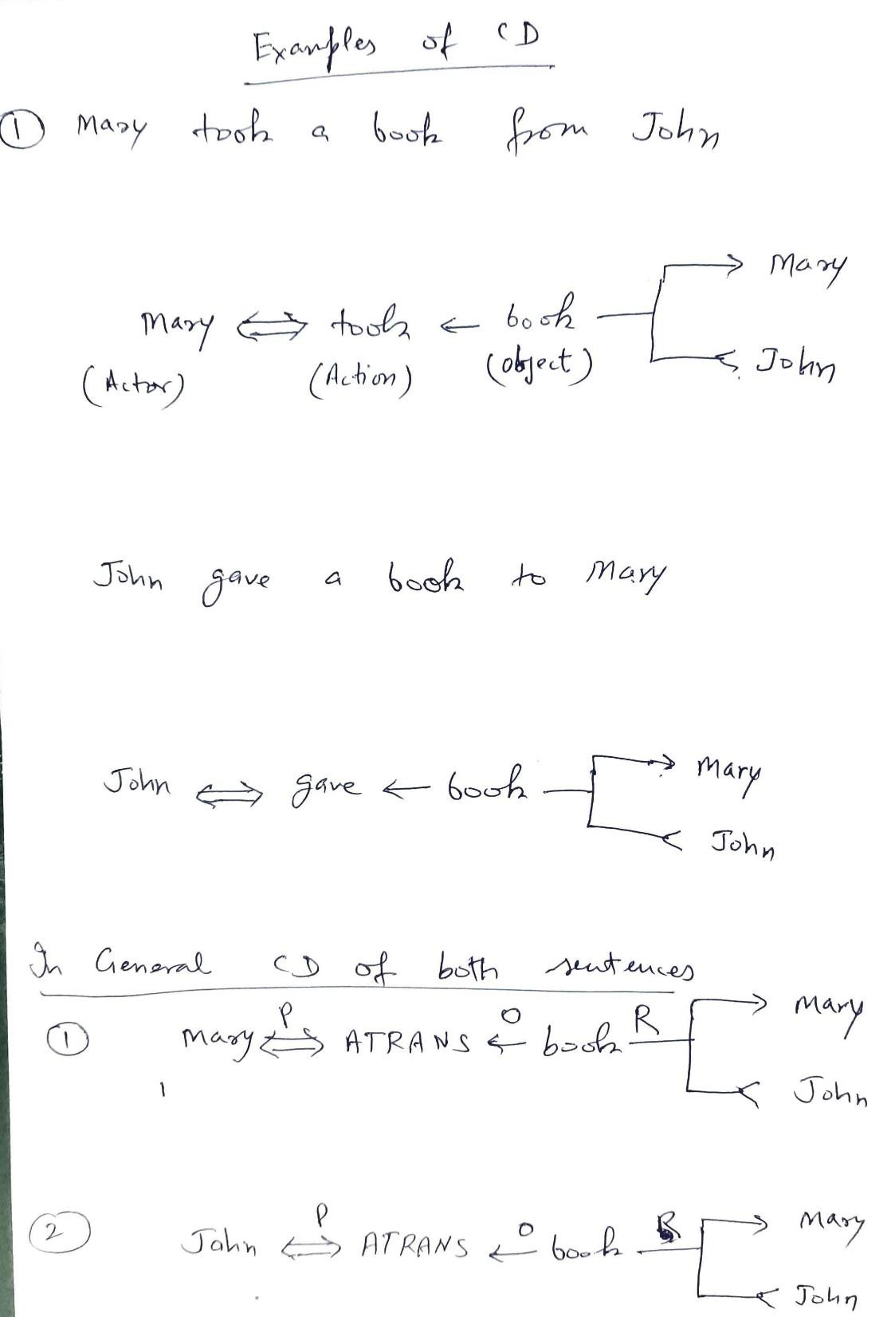

Slide 13
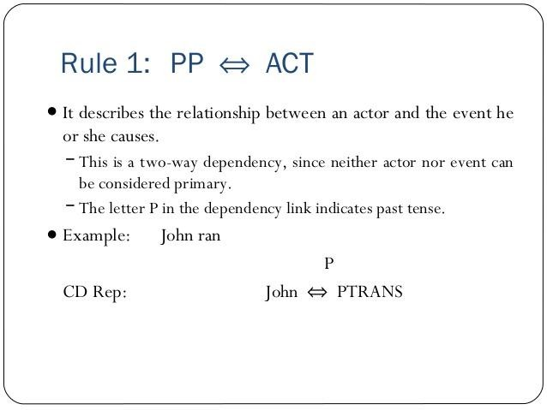

Slide 14

DEPENDENCIES OF CD
Rule 2: PP PA
Example: John is tall.
John height(>average)
Rule 3: PP PP
Example: John is doctor.
John doctor

Slide 15



DEPENDENCIES OF CD
Rule 4: PP PA
Example: Smart John
John Smart
Rule 5: PP PP
Example: John’s dog
_{dog} poss-by_{John}
o
Rule 6: ACT PP
Example: John pushed the bike.
p
o
John PROPEL
bike

Slide 16


DEPENDENCIES OF CD
Rule 7:
R
PP
ACT
PP
Example: John took the book from Mary.
p
R
John
John ATRANS
o
Mary
book
I
Rule 8: ACT
Example: John ate_{p}ice cream with spoon
I
John INGEST John
do
o
o
ice cream
spoon

Slide 17
DEPENDENCIES OF CD
Rule 9:
D
PP
ACT
PP
Example: John fertilized the field.
p
D
field
John PTRANS
o
bag
fertilizer
PA
Rule 10: PP
PA
Example: The plant grew.
size >x
plants
sixe = x

Slide 18
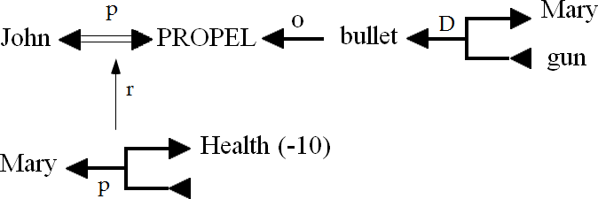
DEPENDENCIES OF CD
Rule 11:
Example: John shot Mary.

Slide 19

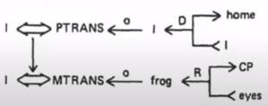
DEPENDENCIES OF CD
T
Rule 12:
Example: John ran yesterday.
yesterday
John
PTRANS
p
Rule 13:
Example: While going home, I saw a frog.

Slide 20
DEPENDENCIES OF CD
PP
Rule 14:
Example: I heard a frog in the woods.
woods
CP
o
R
I
MTRANS
frog
ears

Slide 21
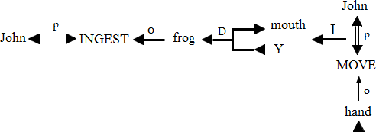

CD EXAMPLES
Example 1: John ate a frog.
Example 2: John threw a ball to Mary.

Slide 22

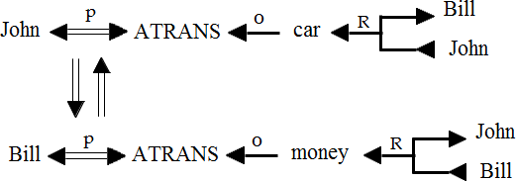
CD EXAMPLES
Example 3: John went to New York.
Example 4: John sold his car to Bill.

Slide 23
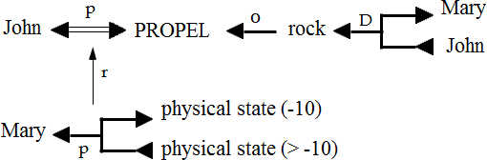

CD EXAMPLES
Example 5: John killed Mary by throwing rock at her.
Example 6: Mary cried.

Slide 24
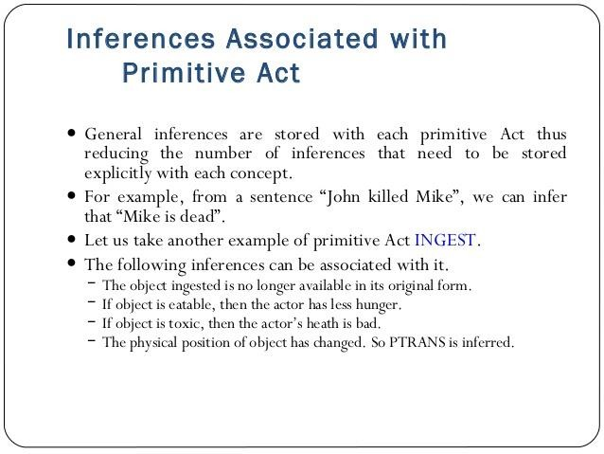

Slide 25
Inferences associated with PTRANS
Inferences associated with INGEST
The object is located at the destination.
The object is no longer at the source.
If a human actor requested the action, then they will probably do
whatever is normally done with the object.
Doing this will cause the person to be pleased.
PTRANS is inferred.
The object ceases to exist in its usual form.
If the object is edible, then the actor is nourished.
If the object is inedible, then the actor becomessick.
If the actor thinks the object tastes good, then the actor is
pleased.
John ate an
apple.
John went to New York from Texas.
John is in New York.
John is no longer in Texas.
John wanted to do something in New York.
John thought he would enjoy being in New
York.
An apple was put into John's
mouth.
The apple ceased to exist.
John was nourished.
5. John liked eating the apple.
John ate
4. John became
sick.
poison.
Inferences associated with PROPEL
Object-based inferences
PTRANS is inferred.
The destination might be negatively affected(physically).
If the destination is human, the actor might have been mad at
him/her.
If the object is brittle then it will become in a negative state.
Additional inferences can be made depending upon the representation of
the objects.
If the object is liquor, then the actor may become
drunk.
If the object is candy, then the actor may get bad
teeth.
If the object is medicine, then the actor may feel better.
John threw an egg at
Mary.
The egg came in contact with Mary.
Mary was hurt.
John was angry at Mary.
The egg was broken.
But these inferences represent information about the objects, and are therefore stored with the object and not the ACT.

Slide 26
SCRIPTS
Conceptual dependencies are used to represent and
reason about an event.
In real time applications, events rarely occur in
isolation.
Script is a structure that describe a sequence of events in particular context scripts such as going to movies, shopping in supermarket, eating in restaurant, banking etc.
A script consists set of slots and information (knowledge) contained in it .
Scripts are beneficial because:
Events tend to occur in known runs or patterns.
Causal relationships between events exist.
Entry conditions exist which allow an event to take place

Slide 27
COMPONENTS OF SCRIPTS
Script Name: - Title
Track: - Special situation, specific variation
Roles:- people involved in the event described in script
Props: - non live objects involved in the Script
Entry condition: - required pre situation to execute the script
Scenes: - The actual sequence of events that occur
Result: - Condition(s) that will be True after execution of script

Slide 28
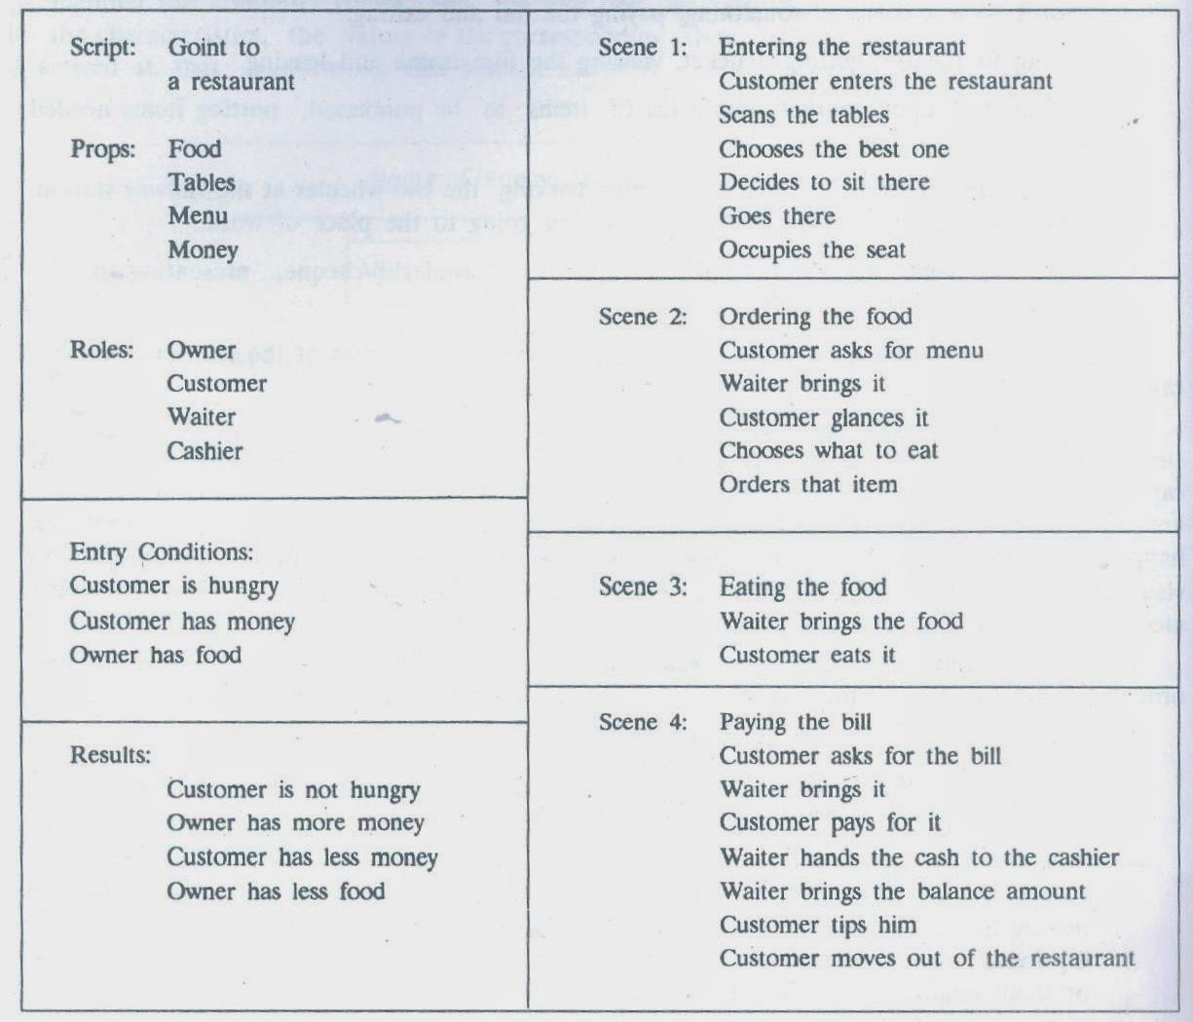
SCRIPT FOR EATING IN RESTURANT

Slide 29
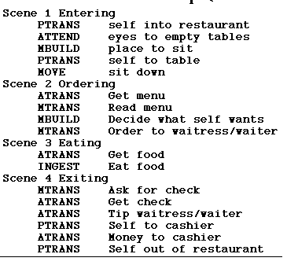
SCRIPT FOR EATING IN RESTURANT

Slide 30
Script Name: -Shopping Script
Track:- Roles: -
Super Market
Shopper , Check out clerk , sacking clerk
Entry Condition: - Shopper needs groceries, food market open
Props: -
Shopping Cart , Display aisles , market items ,checkout stands, money
SCENE1: -
Enter Market
Shopper PTRANS Shopper into Market Shopper PTRANS Shopping Cart to Shopper
SCENE2: -
Shop For Item
Shopper MOVE Shopper through aisles
Shopper ATTEND eyes to display items Shopper PTRANS item to Shopping Cart

Slide 31
SCENE3:-Check Out
Shopper MOVE Shopper to check out stand Shopper ATTEND Eyes to charges
Shopper ATRANS money to check out clerk Sacker ATRANS bag to shopper
SCENE4:-
Exit Market
Shopper PTRANS shopper to exit market
Results:-
Shopper has less money Shopper has grocery items Market has less grocery items Market has more money

